Slide 1
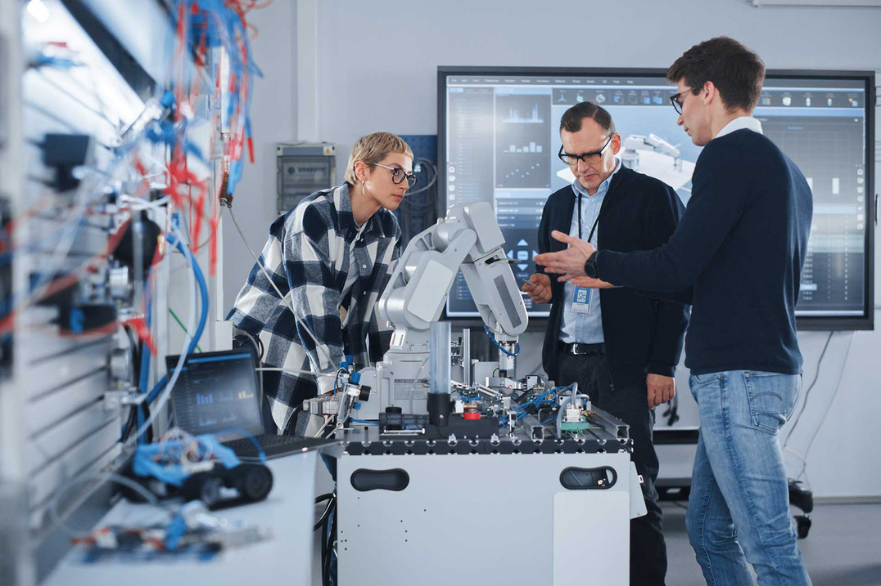


AI- Based Training an Assessment Tool For Vocational Education
24-25J-185
Notes:
‹#›

Slide 2



OUR TEAM
Vilajini.Y
IT2118928
Sujeevan.R
IT20657314
Niles A.P
IT21347726
Notes:
‹#›

Slide 3

Introduction
Research Problem
Objective
Overall System Diagram
Notes:
‹#›

Slide 4
Traditional vocational training methods follow a one-size-fits-all approach, failing to meet individual student needs
Students often lose interest in vocational training due to the lack of interactive and immersive learning experiences.
Research Problems
Traditional assessment methods are slow, leading to delayed that impacts student learning and skill development.
Vocational training programs often fail to keep up with rapidly changing industry demands, leading to outdated skillsets.
Notes:
‹#›

Slide 5
Develop an AI-based training and assessment tool that transforms vocational education by providing personalized learning experiences, automating assessments with real-time feedback, and enhancing student engagement through gamification and interactive learning modules.
Main Objective
Notes:
‹#›

Slide 6
AI-Viva Session
Sub Objectives
Skill-Based Personalized Learning Path
Gamification and Game-Based Learning for Vocational Education
Notes:
‹#›

Slide 7
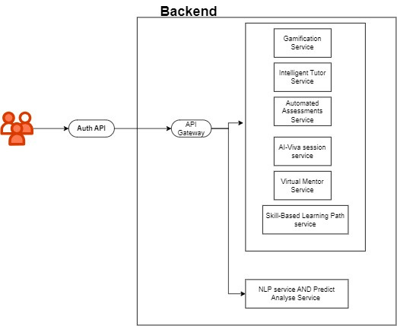
Overall System Diagram
IT21189258 | Vilajini.Y | 24-25J-185
Notes:
‹#›

Slide 8
AI-Viva Session
It21189258
Vilajini.Y
Information Technology
IT21189258 | Vilajini.Y | 24-25J-185
Notes:
‹#›

Slide 9
Background
AI-driven viva sessions simulate multiple questions.
Utilise AI to create a virtual mentor for vocational education.
Facilitate continuous improvement and skill development.
IT21189258 | Vilajini.Y | 24-25J-185
Notes:
‹#›

Slide 10
Research Question
How can AI-Viva sessions be developed to provide personalized assessments and enhance learning outcomes?
IT21189258 | Vilajini.Y | 24-25J-185
Notes:
‹#›

Slide 11


Research Gap
Features | Traditional ITS | AI-Driven Assessment Systems | Proposed System
AI-Driven Viva Simulations
Comprehensive NLP for Assessment
Context-Aware Adaptive Learning
IT21189258 | Vilajini.Y | 24-25J-185
Notes:
‹#›

Slide 12
System Diagram
Methodology
Tools and Technologies
Requirements
IT21189258 | Vilajini.Y | 24-25J-185
Notes:
‹#›

Slide 13
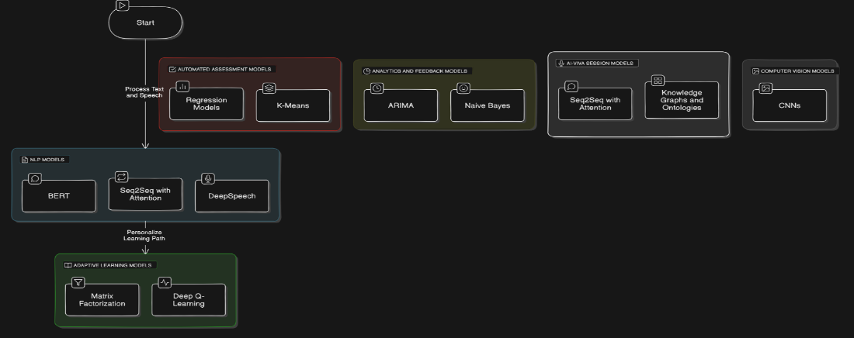
System Diagram
IT21189258 | Vilajini.Y | 24-25J-185
Notes:
‹#›

Slide 14

Tools and Technologies
Flask (Python)
Google-Cloud-API
ChatGPT-API for AI-Chatbot
Firebase Database
NLP
VS code
IT21189258 | Vilajini.Y | 24-25J-185
Notes:
‹#›

Slide 15
Requirements
Functional Requirements
NON-Functional Requirements
User Authentication
AI-Viva Session
Performance Analytics
Content Management
Communication Module
Integration with External Systems
Security
Performance
Reliability
Scalability
Usability
Maintainability
Compatibility
Accessibility
Localization
Data Backup and Recovery
IT21189258 | Vilajini.Y | 24-25J-185
Notes:
‹#›

Slide 16
References
Chassignol, M., Khoroshavin, A., Klimova, A., & Bilyatdinova, A. (2018). Artificial intelligence trends in education: A narrative overview. Procedia Computer Science, 136, 16-24.
Huang, G.-B., Zhu, Q.-Y., & Siew, C.-K. (2006). Extreme learning machine: theory and applications. Neurocomputing, 70(1-3), 489-501.
Jean-Charles, A. (2018). Internet of Things in Education: Artificial Intelligence Voice Assistant in the Classroom. Society for Information Technology & Teacher Education International Conference, 883-885.
Patrick, S., Kennedy, K., & Powell, A. (2013). Mean what you say: Defining and integrating personalised, blended and competency education. International Association for K-12 Online Learning.
IT21189258 | Vilajini.Y | 24-25J-185
Notes:
‹#›

Slide 17
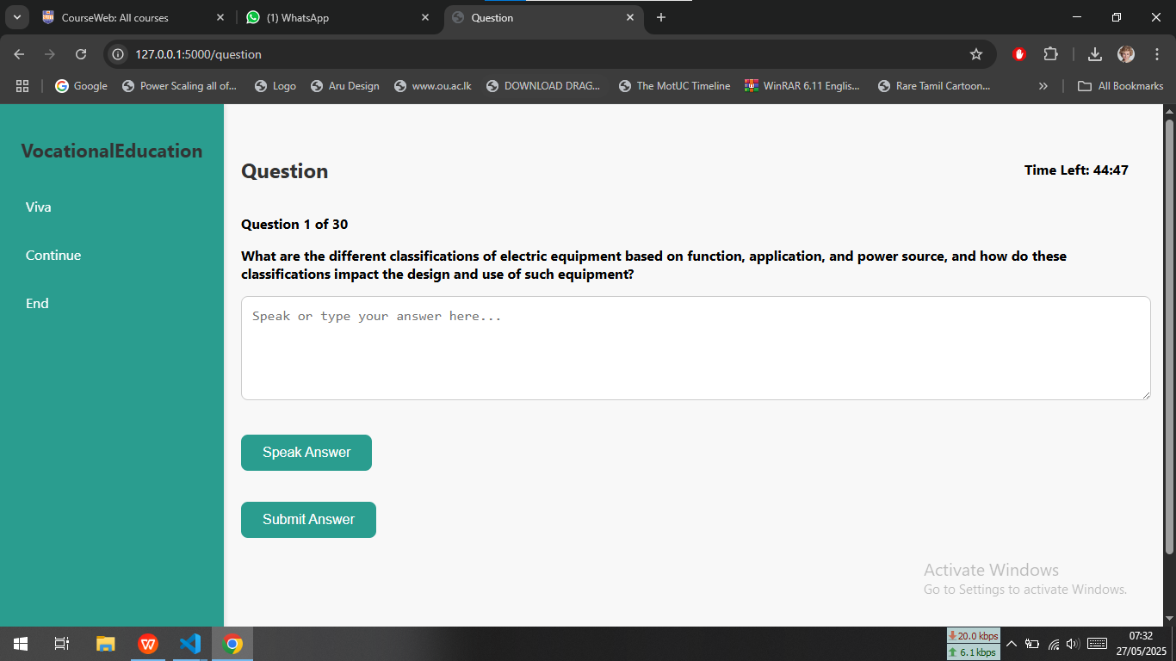
IT21189258 | Vilajini.Y | 24-25J-185
Notes:
‹#›

Slide 18
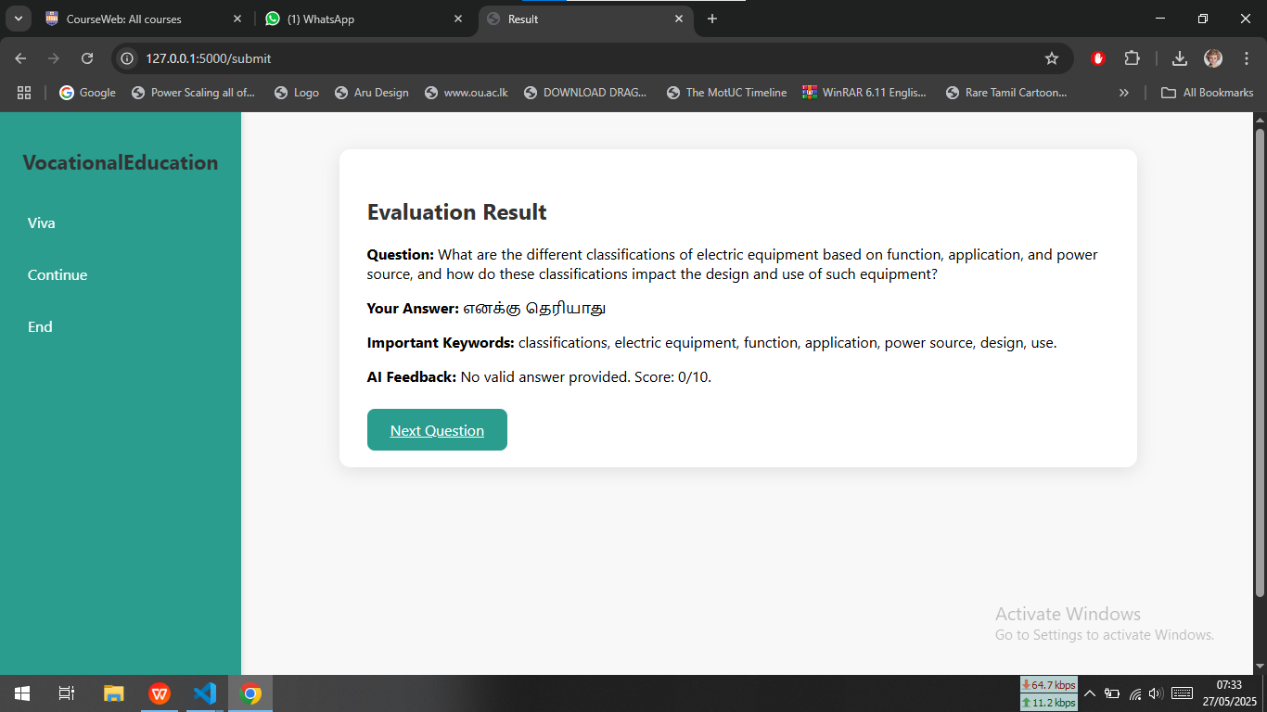
IT21189258 | Vilajini.Y | 24-25J-185
Notes:
‹#›

Slide 19
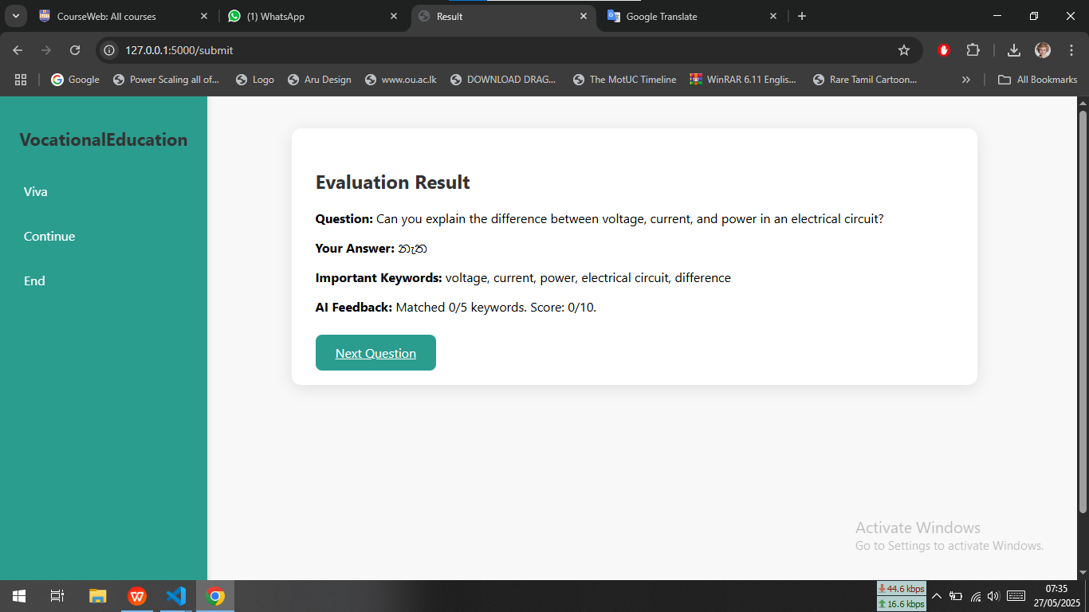
IT21189258 | Vilajini.Y | 24-25J-185
Notes:
‹#›

Slide 20
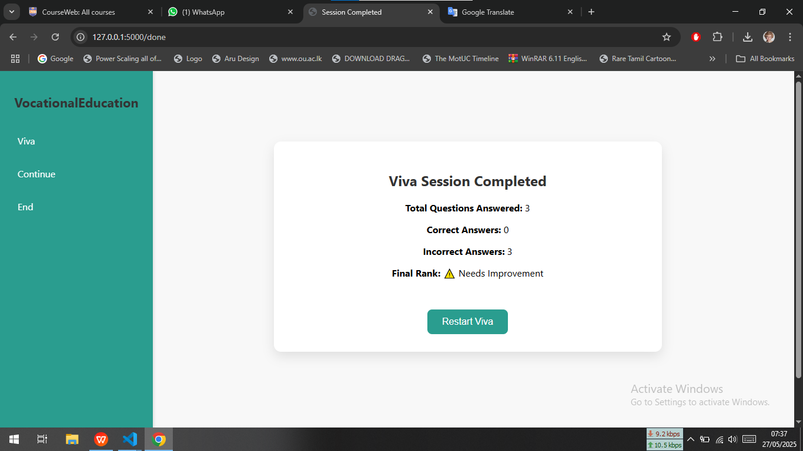
IT21189258 | Vilajini.Y | 24-25J-185
Notes:
‹#›

Slide 21
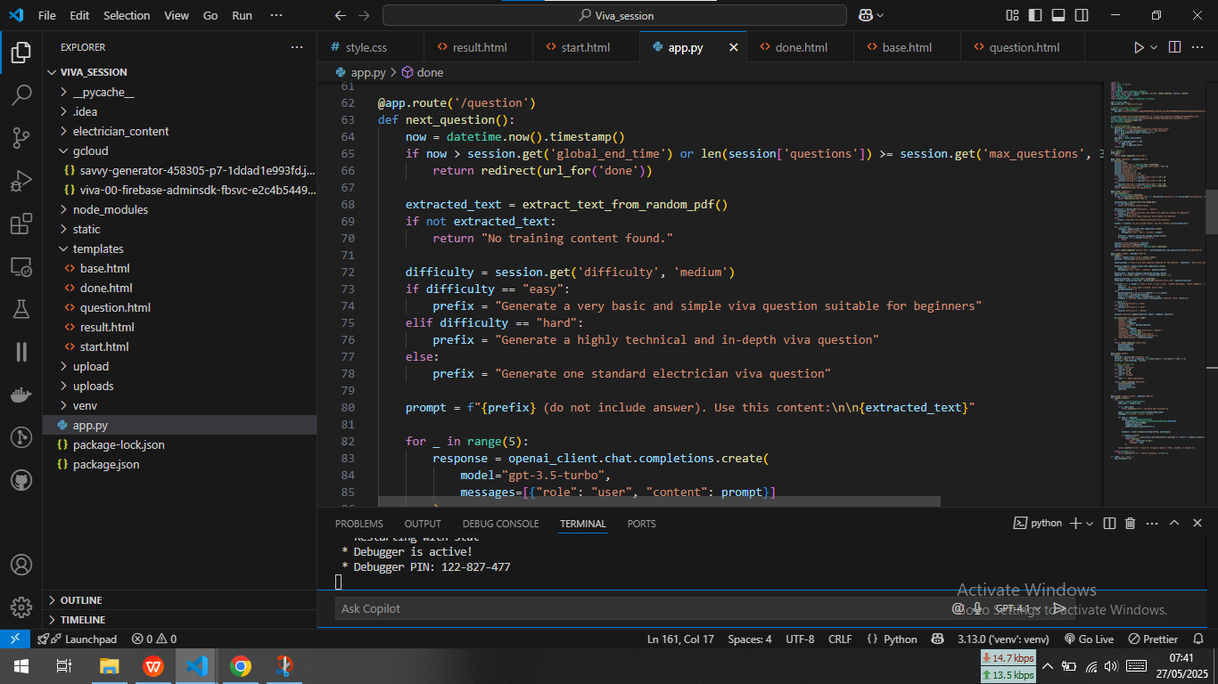
IT21189258 | Vilajini.Y | 24-25J-185
Notes:
‹#›

Slide 22
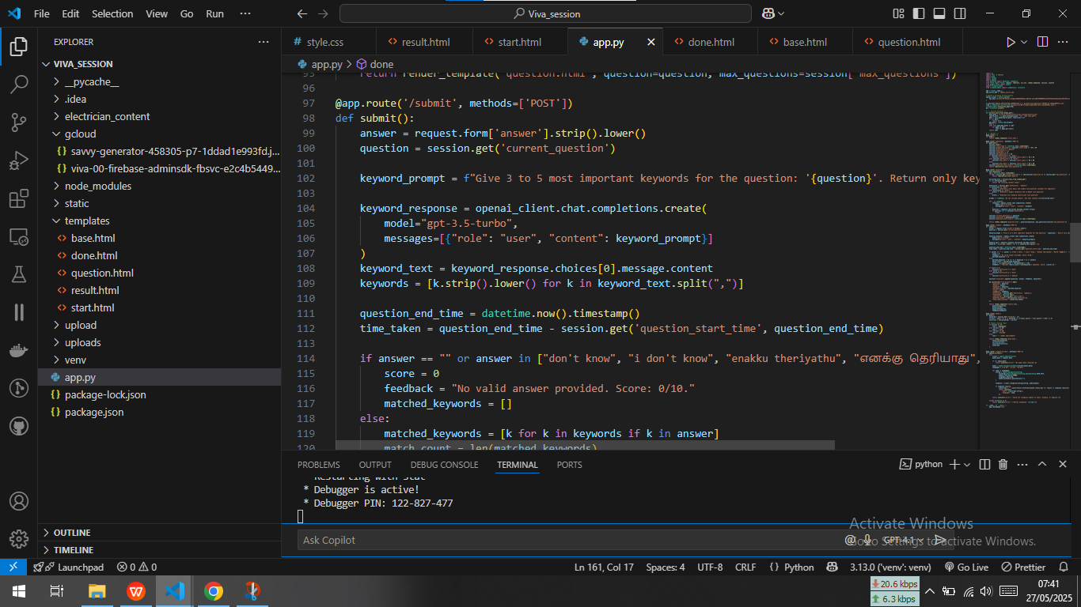
IT21189258 | Vilajini.Y | 24-25J-185
Notes:
‹#›

Slide 23


Skill-Based Personalized Learning Path
IT20657314
Sujeevan.R
Information Technology
IT20656314 | Sujeevan.R | 24-25J-185

Slide 24
Backround
Introduction
Research Question
Research Gap
Objectives
Methodology
IT20656314 | Sujeevan.R | 24-25J-185

Slide 25
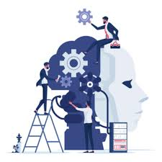
Backround
In recent years, personalised learning has become increasingly important, with a focus on adapting educational experiences to meet individual student needs.
Traditional vocational training is not personalized – same path for all students.
Traditional educational systems often struggle to provide tailored learning paths, which can lead to student disengagement and uneven skill development.
AI-driven learning paths provide real-time adjustments, ensuring students receive appropriate content and challenges
There is no existing AI model for electrician-specific question generation.
IT20656314 | Sujeevan.R | 24-25J-185

Slide 26



How can AI-driven learning enhance personalized education in vocational training for electricians?
What impact does skill-based classification have on student engagement and learning outcomes in vocational education?
How can a machine learning model effectively classify students into skill levels (Beginner, Intermediate, Advanced) based on an initial quiz?
How does real-time adaptation of content and quizzes affect knowledge retention and course progression?
Can AI-generated domain-specific quiz questions improve assessment quality in electrician training?
Research Question
IT20656314 | Sujeevan.R | 24-25J-185

Slide 27
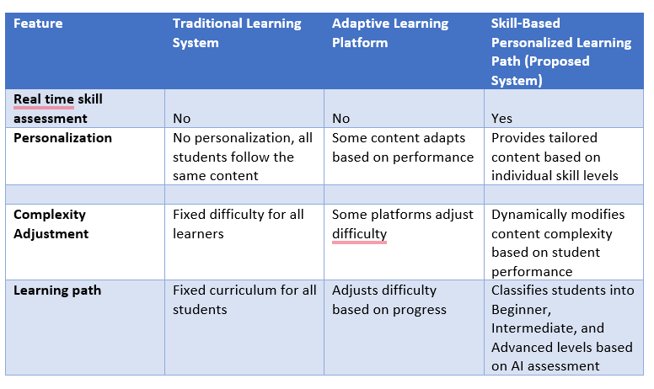
Research Gap
Novelty
AI-Driven Skill Classification
Real-Time Adaptive Learning
Multilingual Learning Environment
Personalized Pathways
Domain-Specific Question Generation
IT20656314 | Sujeevan.R | 24-25J-185

Slide 28




Objectives
Main Objectives
To develop an AI-based educational platform for vocational electrician training that provides skill-based personalized learning paths, supports learning, and uses deep learning to generate domain-specific assessment questions, enhancing learner engagement and outcomes.
Sub Objective
Implement real-time skill evaluation mechanisms
implement a machine learning model for classifying students into Beginner, Intermediate, or Advanced levels.
To develop personalized learning paths based on the classified skill level
To integrate videos, PDFs, and quizzes within each module for effective learning
To train a deep learning model for generating domain-specific quiz questions
To evaluate the system’s effectiveness in improving learning outcomes and course completion rates
IT20656314 | Sujeevan.R | 24-25J-185

Slide 29
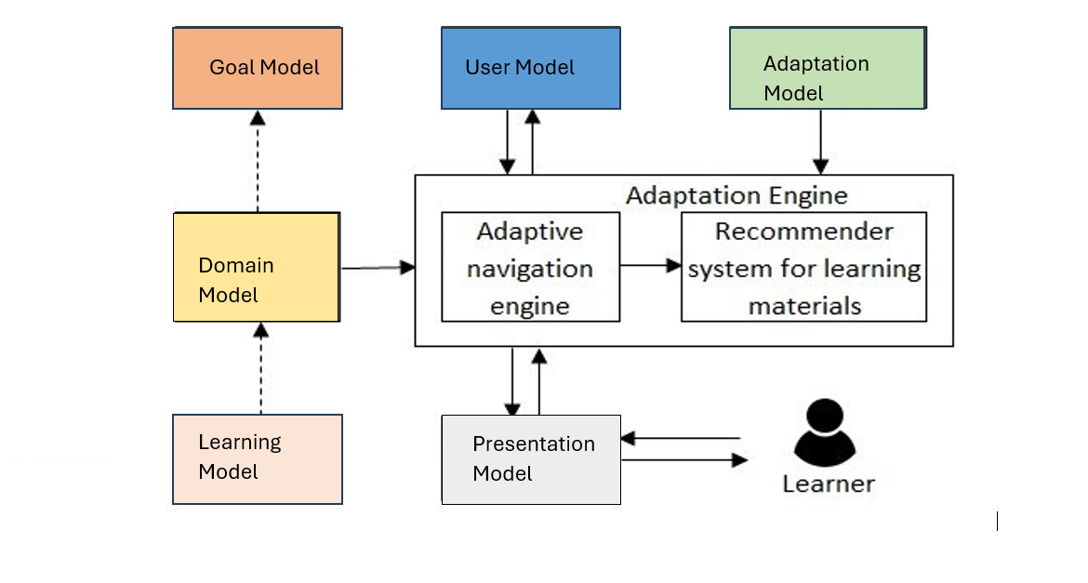
System Diagram
IT20656314 | Sujeevan.R | 24-25J-185

Slide 30

Component Specific Requirements
Functional requirements
Non-functional requirements
User Authentication
Skill-Based Classification System
Adaptive Learning Path
Content Management
Communication Module
Multilingual Support
Integration with External Systems
Availability
Reliability
Speed
Performance
Security
Privacy
IT20656314 | Sujeevan.R | 24-25J-185

Slide 31
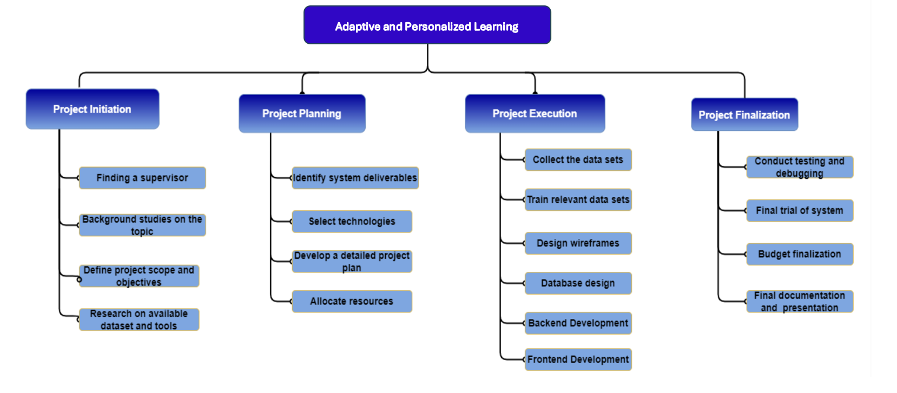
Work Breakdown Structure
IT20656314 | Sujeevan.R | 24-25J-185

Slide 32
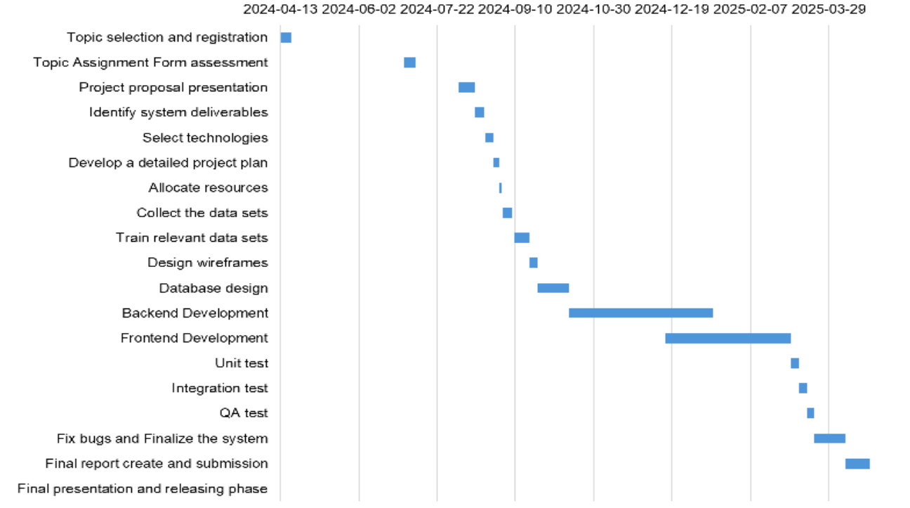
Gantt Chart
IT20656314 | Sujeevan.R | 24-25J-185

Slide 33

Methodology
Requirement Analysis
System Design
Pre-Assessment Quiz Development
Machine Learning Model for Skill Classification
Deep Learning-Based Question Generation
Personalized Learning Path Implementation
Evaluation & Testing

Slide 34



Tools and Technologies
flask
Firebase
React
Google-Cloud-API
OpenAI GPT API
IT20657314 | sujeevan.R | 24-25J-185

Slide 35
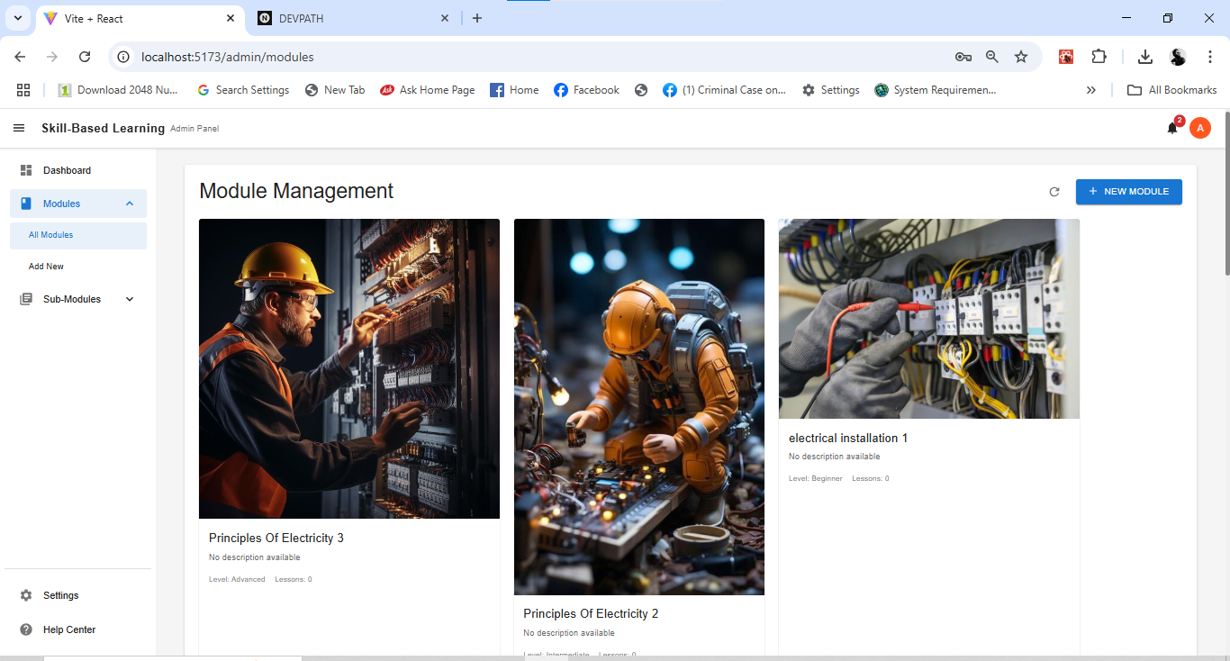
Work Done
IT20657314 | sujeevan.R | 24-25J-185

Slide 36
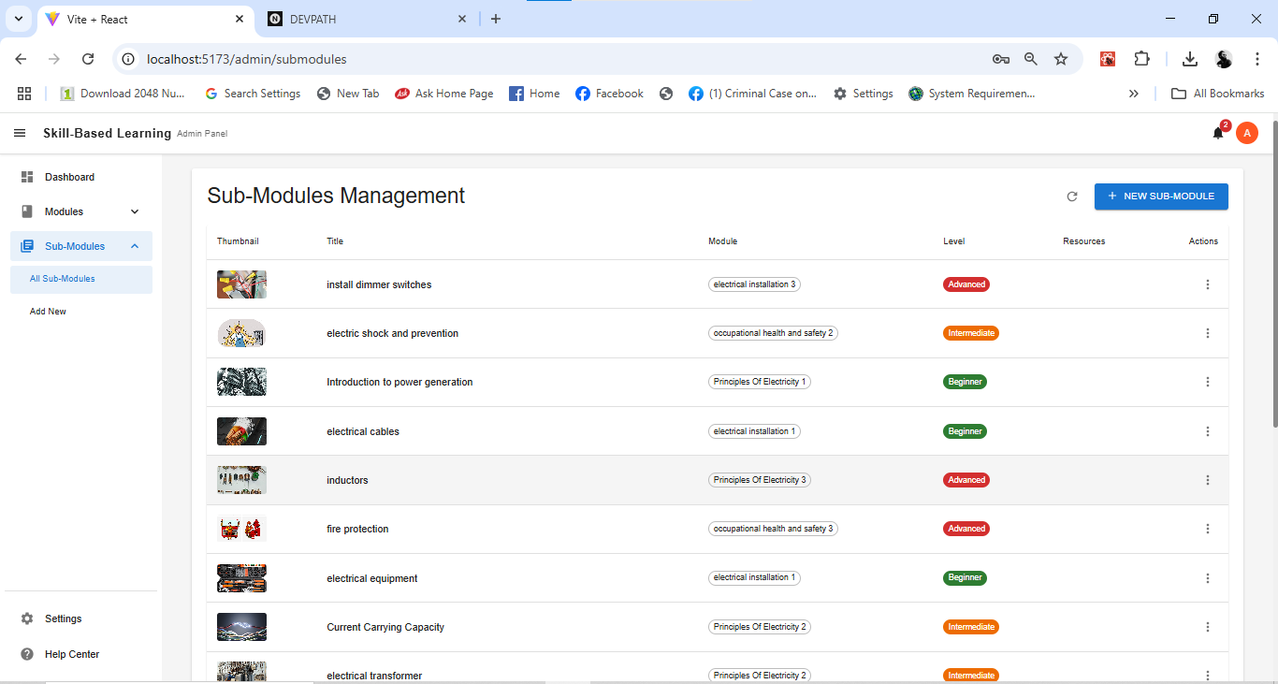
Work Done
IT20657314 | sujeevan.R | 24-25J-185

Slide 37
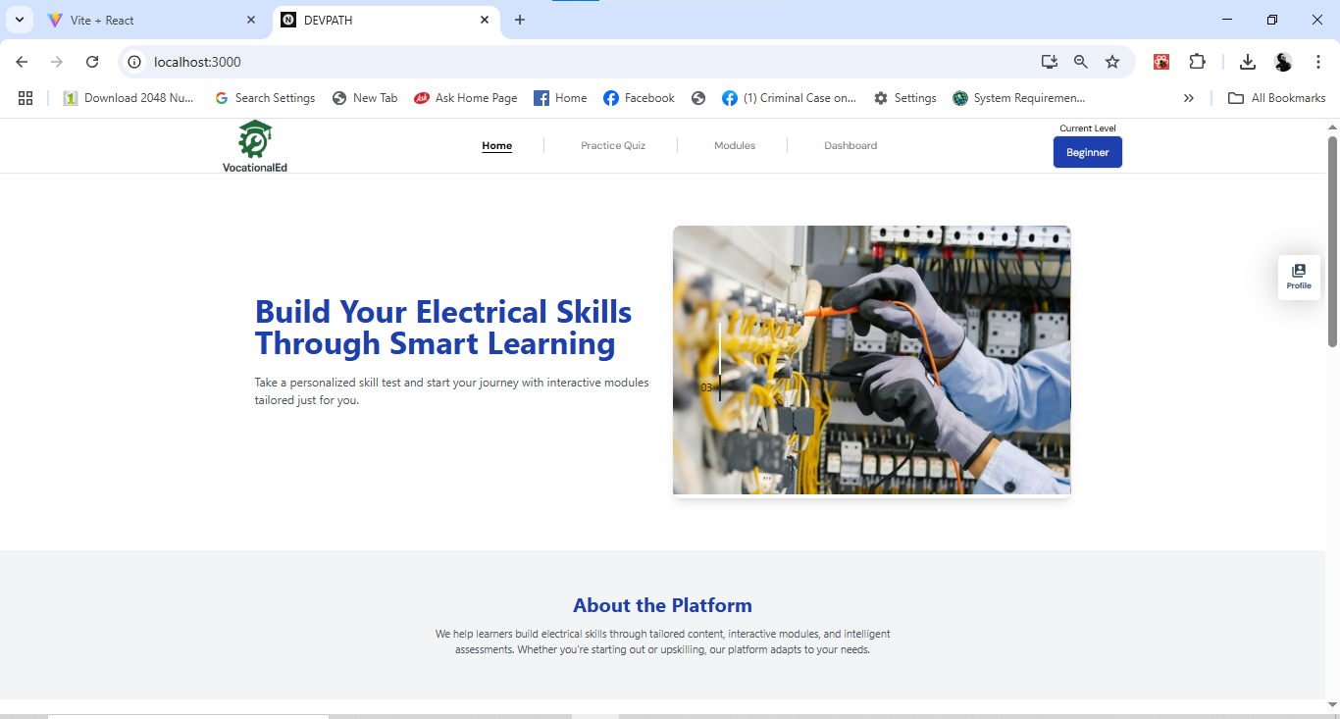
Work Done
IT20657314 | sujeevan.R | 24-25J-185

Slide 38
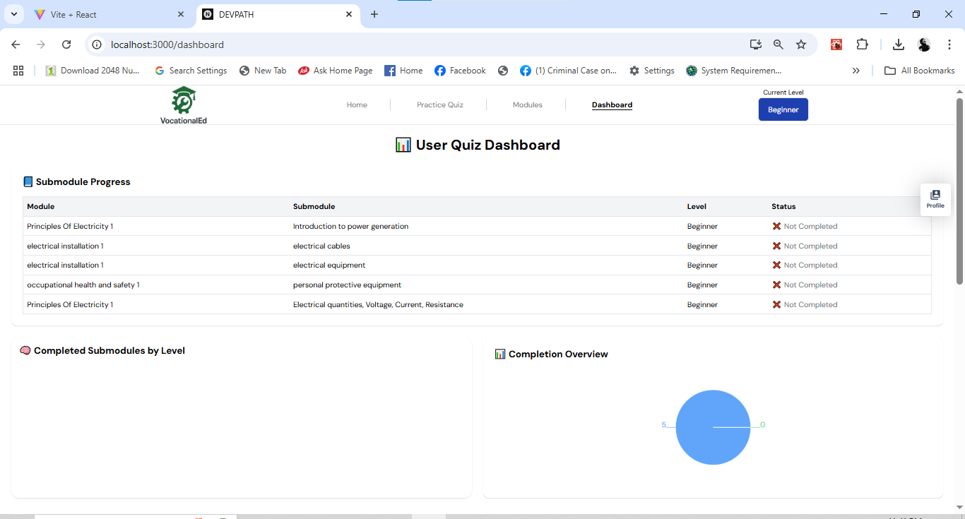
Work Done
IT20657314 | sujeevan.R | 24-25J-185

Slide 39
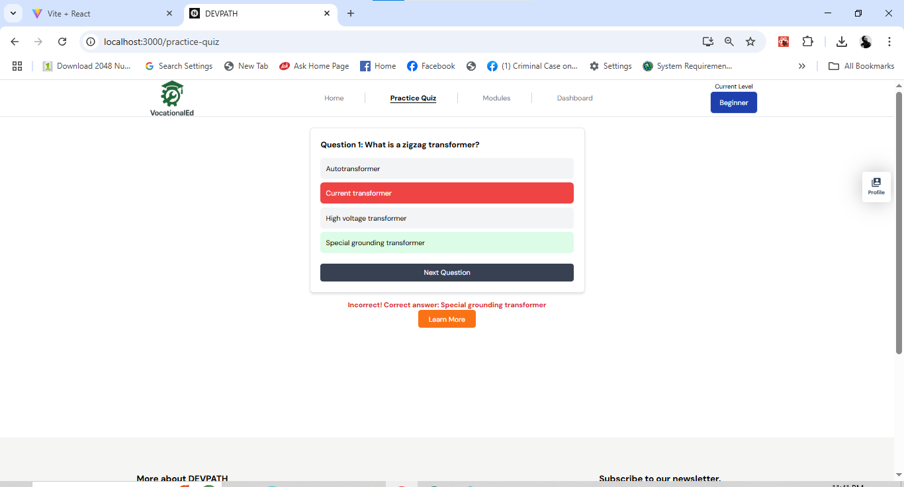
Work Done
IT20657314 | sujeevan.R | 24-25J-185

Slide 40
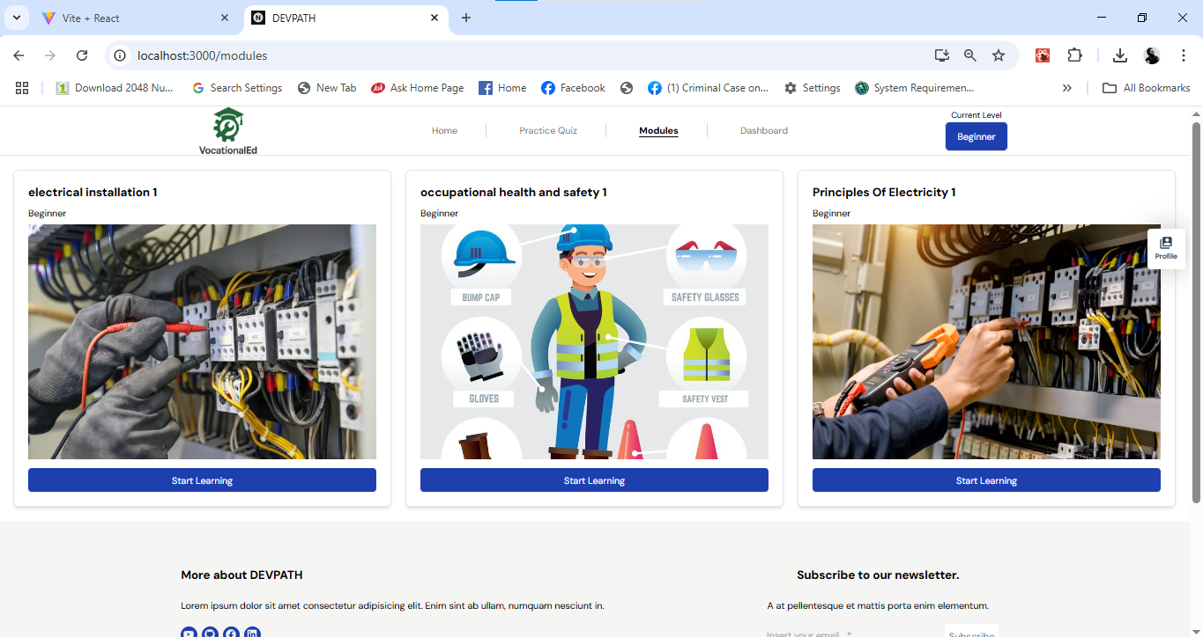
Work Done
IT20657314 | sujeevan.R | 24-25J-185

Slide 41
References
[1]J. Smith, R. Patel, and M. Brown, "AI-Driven Personalized Learning Systems: A Review," in Proc. IEEE Int. Conf. on e-Learning, 2023, pp. 124-129.
[2]A. Gomez, P. Clark, and S. Johnson, "Machine Learning Techniques for Personalized Education," in Proc. IEEE Global Engineering Education Conference (EDUCON), 2023, pp. 678-682.
[3]M. K. Lee and T. Kim, "Personalized Learning in AI-Enhanced Classrooms," in IEEE Transactions on Learning Technologies, vol. 15, no. 3, pp. 788-797, 2023.
IT20656314 | Sujeevan.R | 24-25J-185

Slide 42

Gamification and Game-Based Learning for Vocational Education
IT21347726
Niles A.P
Information Technology
IT21347726 | Niles A.P | 24-25J-185
08/07/24
<number>

Slide 43
Backround
Introduction
Research Question
Research Problems
Objectives
Methodology
IT21347726 | Niles A.P | 24-25J-185

Slide 44
Backround
Why is Gamification and Game-Based Learning for Vocational Education important?
Gamification and Game-Based Learning in vocational education make learning more engaging and effective by integrating interactive elements. This approach enhances skill development, motivation, and real-world application, better preparing students for modern job demands.
IT21347726 | Niles A.P | 24-25J-185

Slide 45
Research Problem
Main reasons why Gamification and Game-Based Learning for Vocational Education is important?
Enhanced Engagement: Increases student motivation and active participation in learning activities.
Practical Skill Development: Provides hands-on, risk-free practice of real-world tasks.
Improved Learning Outcomes: Facilitates better retention and understanding of complex concepts.
Personalized Learning: Adapts to individual student needs, allowing for customized learning paths.
IT21347726 | Niles A.P | 24-25J-185

Slide 46
Objectives
Main Objectives
Develop and implement gamified learning modules tailored for vocational education where students can engage in a more gamified way of learning.
Sub Objective
Identify and gamify key concepts in electrical systems.
Develop interactive modules with quizzes and games.
Develop games that engage students
IT21347726 | Niles A.P | 24-25J-185

Slide 47
System Diagram
Methodology
Tools and Technologies
Requirements
IT21347726 | Niles A.P | 24-25J-185

Slide 48
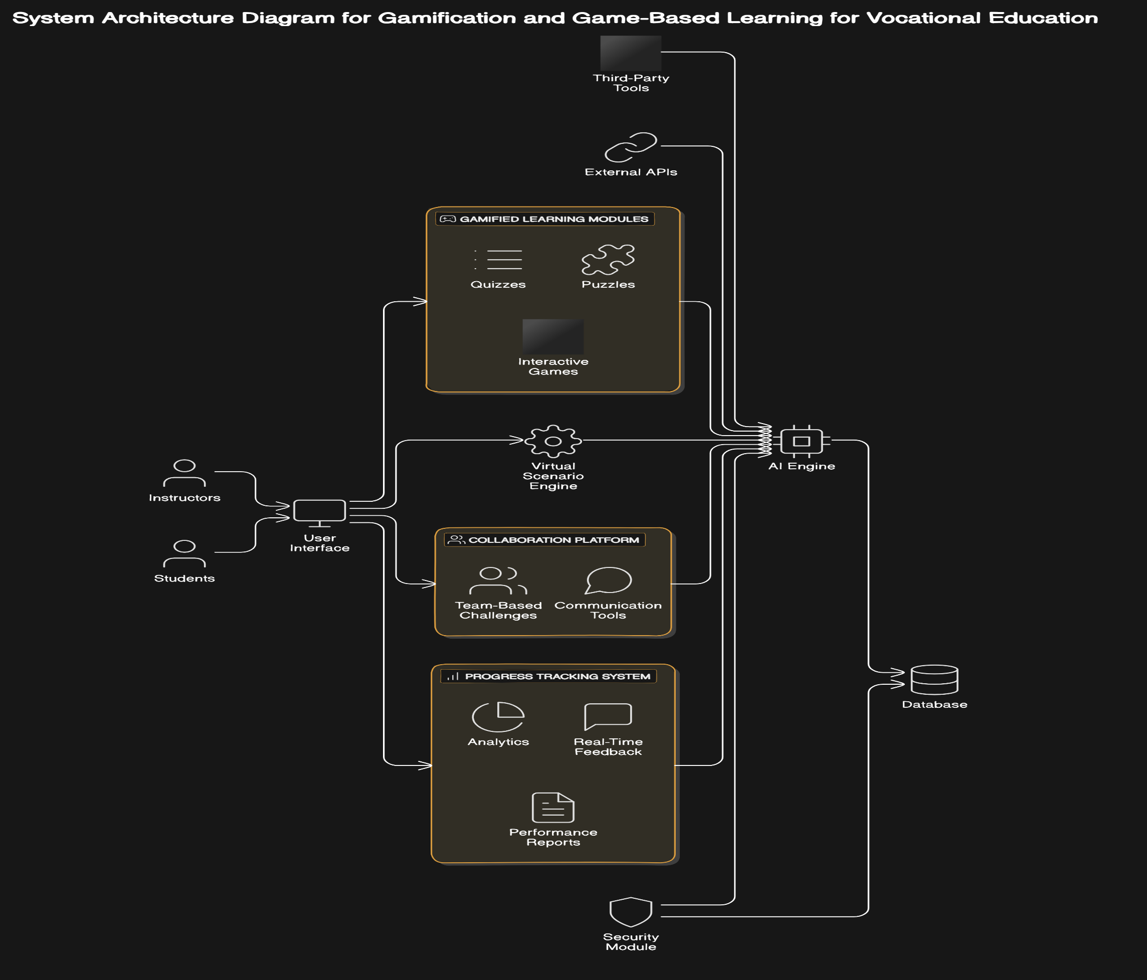
System Diagram
IT21347726 | Niles A.P | 24-25J-185

Slide 49



Tools and Technologies
C#
Python
Django
PostgreSQL
React
GitHub for version control
MS Planner for Project Management
IT21347726 | Niles A.P | 24-25J-185

Slide 50
Project Requirements
Functional requirements
Non-functional requirements
Provide gamified modules with quizzes and puzzles for electrical.
Scalability
Usability
Performance
Security
Reliability
Compatibility
IT21347726 | Niles A.P | 24-25J-185

Slide 51
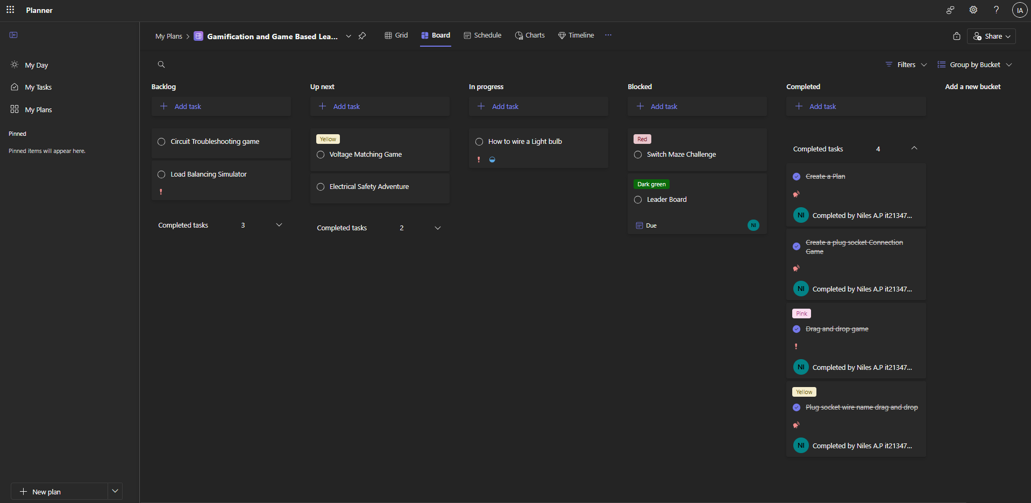
Project Management - MS Planner
IT21347726 | Niles A.P | 24-25J-185

Slide 52
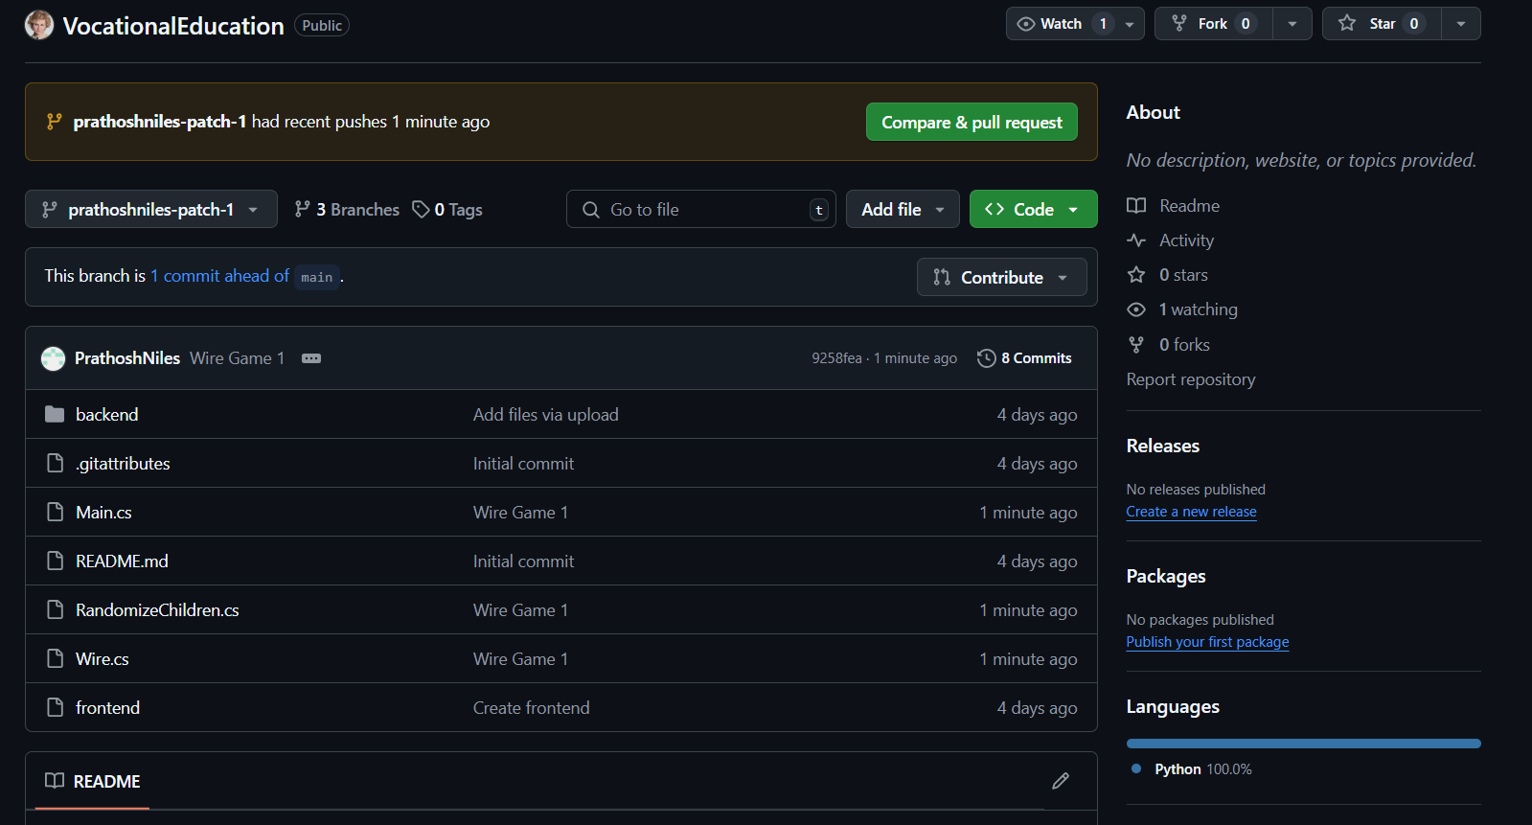
GitHub Commits
IT21347726 | Niles A.P | 24-25J-185

Slide 53

Work Done
IT21347726 | Niles A.P | 24-25J-185

Slide 54
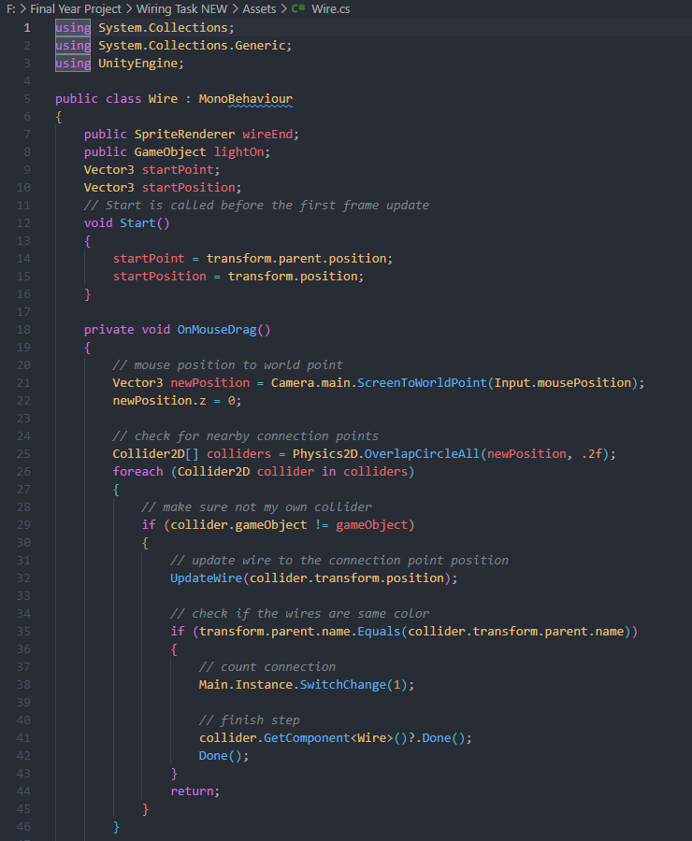
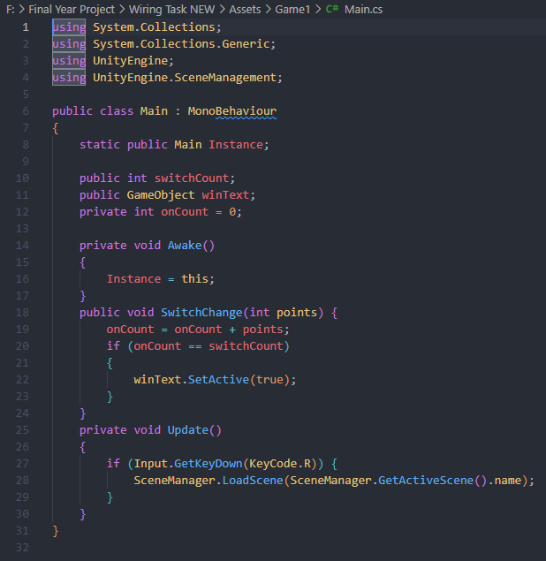
Work Done
IT21347726 | Niles A.P | 24-25J-185

Slide 55
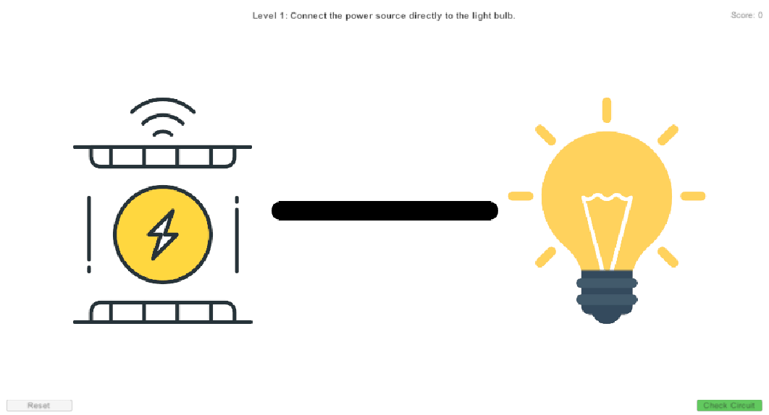
Work Done
IT21347726 | Niles A.P | 24-25J-185

Slide 56
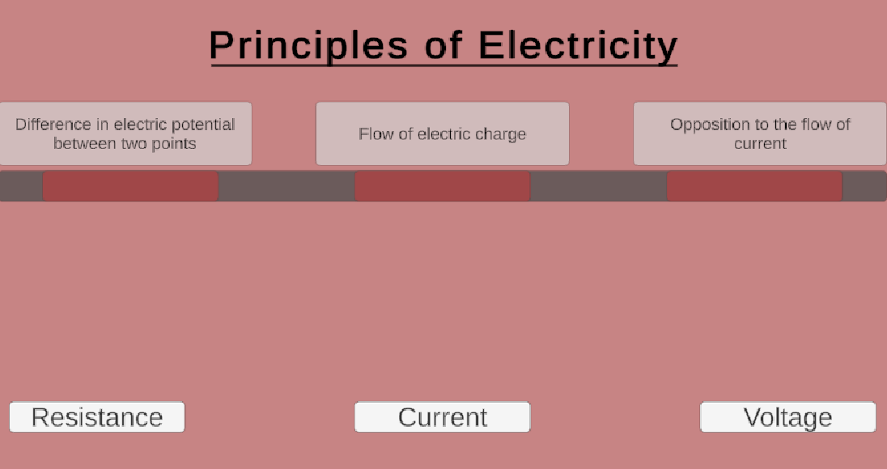
Work Done
IT21347726 | Niles A.P | 24-25J-185

Slide 57
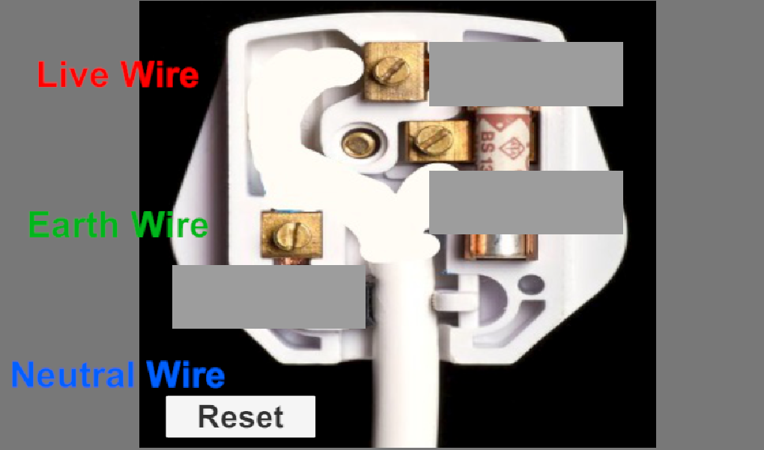
Work Done
IT21347726 | Niles A.P | 24-25J-185

Slide 58
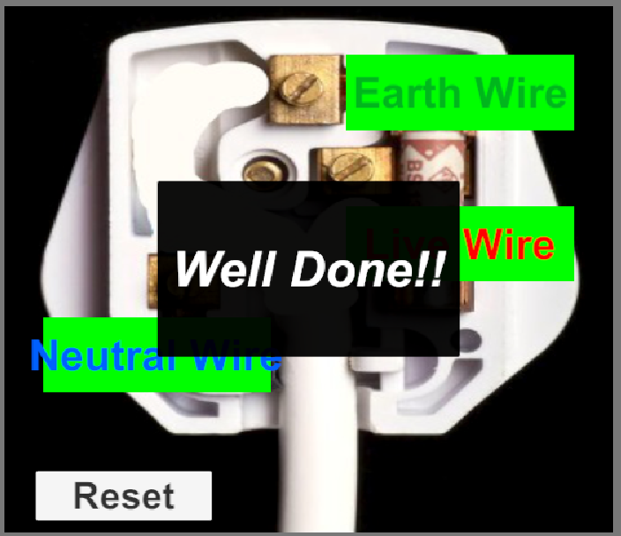
Work Done
IT21347726 | Niles A.P | 24-25J-185

Slide 59
References
[1] T. H. Hsu, K. H. Lin, and Y. C. Kuo, "Gamification for Vocational Education: An Empirical Study of a Gamified Learning System," IEEE Access, vol. 8, pp. 88910-88922, 2020. DOI: 10.1109/ACCESS.2020.2995947.
[2] M. Al-Ali, H. S. Al-Omari, and F. A. Al-Debei, "The Impact of Game-Based Learning on Vocational Training: A Case Study," IEEE Transactions on Education, vol. 62, no. 3, pp. 154-161, Aug. 2019. DOI: 10.1109/TE.2019.2915110.
[3] Y. G. Li, Y. H. Chen, and J. J. Huang, "Design and Evaluation of a Gamified Learning Platform for Vocational Training," IEEE Transactions on Learning Technologies, vol. 12, no. 1, pp. 60-69, Jan.-Mar. 2019. DOI: 10.1109/TLT.2018.2879476.
[4] L. H. Yang, J. C. Chen, and M. K. Tsai, "Integrating Gamification into Vocational Education: A Study on Learning Outcomes and Engagement," IEEE Transactions on Education, vol. 65, no. 4, pp. 381-388, Nov. 2022. DOI: 10.1109/TE.2022.3165629.
IT21347726 | Niles A.P | 24-25J-185

Slide 60


